Slide 1
L1 Introduction and Overview
Z. Gu 2021

Slide 2
Logistics
Lecture Times
Mon, Wed 14:00-16:00
Instructors
Z. Gu, Kalle Prorok
Zoom link: https://umu.zoom.us/j/61403558067

Slide 3
My Instruction Style
No textbook. Will discuss classic techniques as well as latest research advances.
I provide detailed, self-contained PowerPoint slides.
All exam questions will come from these slides. Some slides may be verbose for the sake of completeness.
In-class questions and discussions are welcome. You can either speak up during lecture, or type in the chat window. For questions after class, please use the Canvas discussion board so everyone can see the discussions.
Lecture videos are recorded and available in UmU Play, so in-class attendance is not mandatory.

Slide 4
Lecture Schedule (Tentative)
Weekly lecture topics
W1: Introduction and overview
W2: Functional Safety and ISO 26262 (no class on 5 Apr Mon. Easter Monday)
W3: Perception (Intro to ML/DL, CNN)
W4: Planning
W5: Control algorithms (PID, MPC)
W6-7: (Deep) Reinforcement Learning
W8-9: RL applications in AD
W10-11: Advanced topics (security attacks and defenses, uncertainty estimation, out-of-distribution detection…)
I will put lecture materials here instead of on Canvas. Please bookmark this link
https://guzonghua.github.io/saav/
Since I may update slides slightly after each class, it is more convenient to put them here
Notes:
Sensor fusion with filters (Kalman, Particle, UKF)

Slide 5
Lab Sections
Labs
Lab1 in W3-4. Traffic sign classification with CNN
Lab2 in W5-6. Adversarial attacks on CNN classifier
Lab3 in W7-8. PID control
Lab4-5 in W9-10. RL applications in AD
Kalle will provide brief tutorials on related software frameworks throughout the term
Grade distribution:
Final exam (open-book): 60%
Lab sections: 40%
We will keep the projects’ computing demands low, so you can use Google Colab, or work on your own computer without powerful GPUs
We will also keep the programming workload relatively low, e.g., you may be given a semi-complete program, and asked to tune some hyper parameters, or fill in a few lines of missing code. Programming language is Python
Notes:
Unity ML (https://unity3d.com/machine-learning).
Lab1: PID controller for lane tracking
Lab2: MPC controller for trajectory optimization
Lab3: Reinforcement Learning (DQN)
Lab4: Reinforcement Learning (PPO or Actor-Critic)

Slide 6
Today’s Agenda
I will give a broad review of the major issues involved in AD.
Background
Sensors and perception
HD maps
Hardware platforms
Software platforms
AV Safety
Ethical Issues
V2X

Slide 7
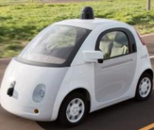
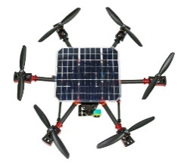
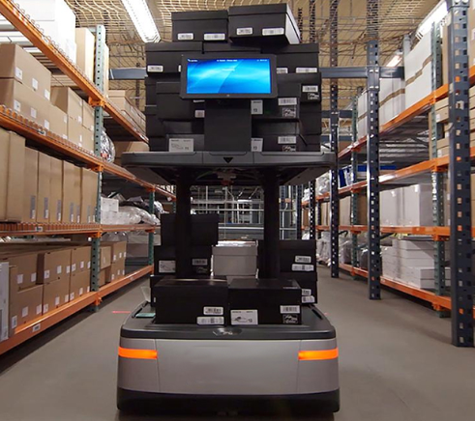
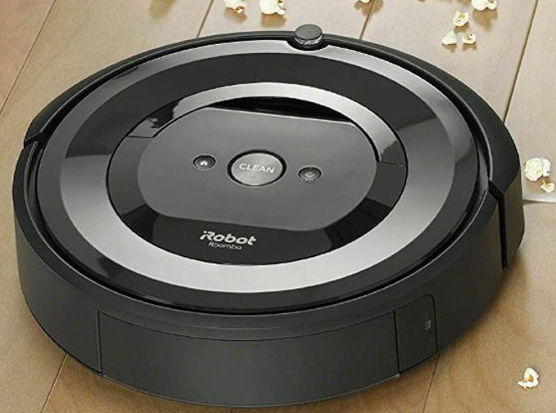
Autonomous Vehicles (AVs)
Can refer to any type of Autonomous Mobile Robot.
Not just Self-Driving Cars (SDCs)
Many techniques for SDCs covered in this course are generally applicable to other types of AVs.
Self-Driving Cars
Drones
Warehouse Robots
Indoor-Cleaning Robots

Slide 8
Why AD?
Reduced traffic accidents and fatalities
In the USA: in 2019, an estimated 38,800 people lost their lives to car crashes. About 4.4 million people were injured seriously enough to require medical attention in crashes.
Reduced congestion and pollution
More productive time spent on the road
Autonomous Mobility-on-Demand (AMoD) with a fleet of AVs
Low-cost, safe and efficient mode of transportation that may make vehicle ownership obsolete.
The dream of Uber (and many other companies)
Notes:
An average North American
spends 100 minutes per day driving.
total of ~38k hours, 1.3 million miles in his/her lifetime, which is more than 3x distance to the moon.
Traffic deaths – a 2% decline from 2018 (39,404 deaths) and a 4% decline from 2017 (40,231 deaths)
~1.25 million fatalities globally
https://www.nsc.org/road-safety/safety-topics/fatality-estimates

Slide 9
Advanced Driver Assistance (ADAS)
Since the initial introduction of Cruise Control in 1948, ADAS functions are increasingly prevalent in modern vehicles.
Adaptive cruise control (ACC), Anti-lock braking system, Collision avoidance system (Pre-crash system), Driver Monitoring System (DMS), Electronic Stability Control (ESC), Forward Collision Warning (FCW), Lane Departure Warning (LDW), Lane Change Assistance, Surround View…
https://en.wikipedia.org/wiki/Advanced_driver-assistance_systems

Slide 10
DARPA Grand Challenge (2004)
Held in the Mojave Desert region of the USA, along a 150-mile (240 km) route.
None of the robot vehicles finished the route. Carnegie Mellon University's Red Team and car Sandstorm (a converted Humvee) traveled the farthest distance, completing 11.78 km (7.32 mi) of the course before getting hung up on a rock after making a switchback turn.
No winner was declared, and the cash prize was not given.

Slide 11
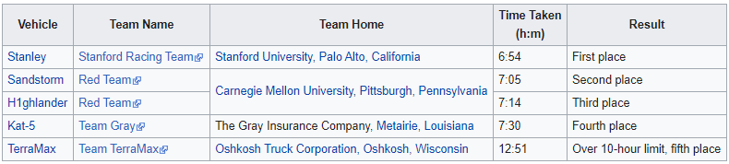
DARPA Grand Challenge (2005)
Vehicles passed through three narrow tunnels and negotiated more than 100 sharp left and right turns.
Five vehicles successfully completed the 212 km (132 mi) course. Stanford’s Stanley won the $2M top prize.

Slide 12
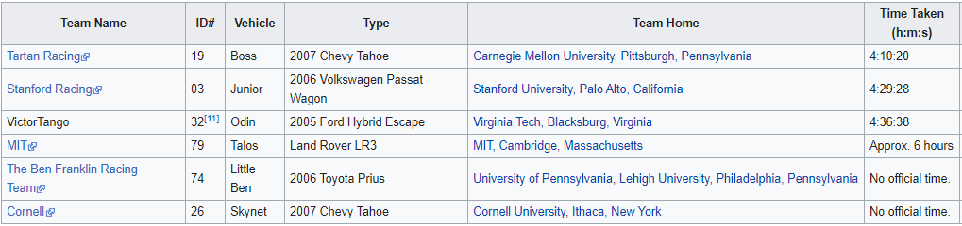
DARPA Urban Challenge (2007)
Held at the site of the now-closed George Air Force Base. The course involved a 96 km (60 mi) urban area course, to be completed in less than 6 hours. Rules included obeying all traffic regulations while negotiating with other traffic and obstacles and merging into traffic.
CMU’s Boss won the $2M top prize, and Stanford’s Junior won the $1M second prize.
The 3 Grand Challenge races jump-started the Self-Driving Car industry. Faculty and students from winning teams such as Stanford and CMU later became leaders in SDC projects at companies like Google/Waymo and Uber and numerous startups.

Slide 13
Highway vs. City Driving
Highway driving is perceived as an easier problem than city driving.
Has potential of massive displacement of truck driver jobs
But traffic merging is tricky and may require human operator assistance
 | Highway Driving | City Driving
Travel Speed | High | Low to medium
Traffic Volume | High | Medium to high
Number of Lanes | Large (6-8) | Small (2-4)
Others | Entry and exit points for traffic merging | Many intersections with traffic lights

Slide 14
Brief History of SDCs
Google’s AV passes a 14-mile driving test in Nevada
Uber hires 40 CMU robotics researchers to work on AVs; Ford begins testing its AVs.
NHTSA issues revised safety guidelines for AVs
DARPA Grand Challenges
Google begins AV project
Tesla releases Auto-Pilot
2004/05
2009
2012
2015
2015
2017
2007
2013
2013
2016
2016
DARPA Urbane Challenge
Mercedes and Infiniti produce cars with radar sensors and some AD features
NHTSA
releases initial policy on AVs
Major acquisitions and partnerships (GM and Cruise Automation; GM and Lyft; Toyota and Jaybridge Robotics; Uber and Volvo)
NHTSA issues guidelines for testing and deployment of AVs
https://www.mcca.com/wp-content/uploads/2018/04/Autonomous-Vehicles.pdf

Slide 15
Operational Design Domain (ODD)
The ODD defines the conditions under which a vehicle is designed to function and is expected to perform safely. The ODD includes (but isn’t limited to) environmental, geographical, and time-of-day restrictions, as well as traffic or roadway characteristics.
e.g., an autonomous freight truck might be designed to transport cargo from a seaport to a distribution center 30 Km away, via a specific route, in day-time only. This vehicles ODD is limited to the prescribed route and time-of-day, and it should not operate outside of it

Slide 16
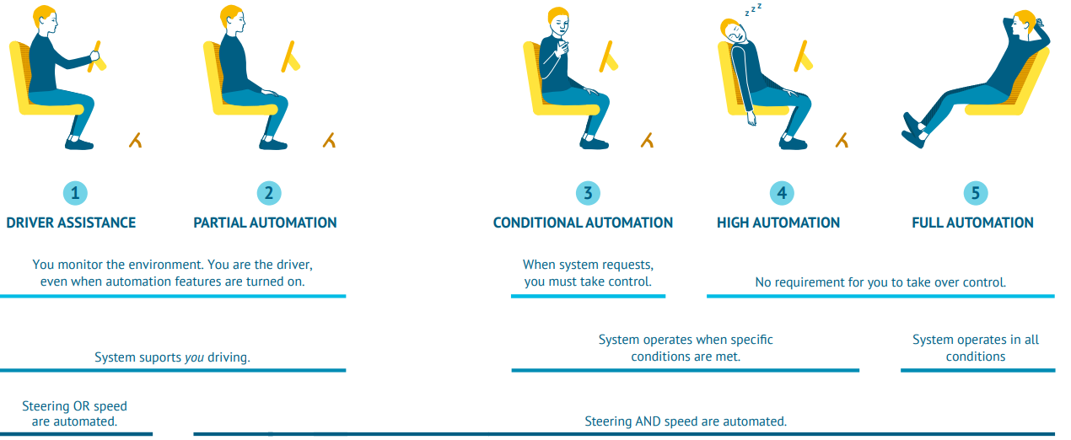
Five Levels of Automation
L1: ADAS features that either control steering or speed to support the driver.
L2: both steering and acceleration are simultaneously handled by AD system. The human driver still monitors the environment and supervises the support functions.
L3: Conditional automation: the system can drive without the need for a human to monitor and respond. However, the system might ask a human to intervene, so the driver must be able to take control at all times.
L4: These systems have high automation and can fully drive themselves under certain conditions. The vehicle won’t drive if not all conditions are met.
L5: Full automation, the vehicle can drive wherever, whenever, with unlimited ODD.
https://www.wevolver.com/article/2020.autonomous.vehicle.technology.report
Notes:
https://www.sae.org/news/press-room/2018/12/sae-international-releases-updated-visual-chart-for-its-“levels-of-driving-automation”-standard-for-self-driving-vehicles
Level 1 (L1): Advanced Driver Assistance Systems (ADAS) are introduced: features that either control steering or speed to support the driver. For example, adaptive cruise control that automatically accelerates and decelerates based on other vehicles on the road. Level 2 (L2): Now both steering and acceleration are simultaneously handled by the autonomous system. The human driver still monitors the environment and supervises the support functions. Levels of driving automation summary. Adapted from SAE by Wevolver. [6] Level 3 (L3): Conditional automation: The system can drive without the need for a human to monitor and respond. However, the system might ask a human to intervene, so the driver must be able to take control at all times. Level 4 (L4): These systems have high automation and can fully drive themselves under certain conditions. The vehicle won’t drive if not all conditions are met. Level 5 (L5): Full automation, the vehicle can drive wherever, whenever.
Examples are systems where the driver controls steering and the automated system controls engine power to maintain a set speed (Cruise Control) or engine and brake power to maintain and vary speed (Adaptive Cruise Control or ACC); and Parking Assistance, where steering is automated while speed is under manual control. The driver must be ready to retake full control at any time. Lane Keeping Assistance (LKA) Type II is a further example of Level 1 self-driving. The Automatic Emergency Braking feature which alerts the driver to a crash and deploys full braking capacity is also a Level 1 feature.
Level 1 ("hands on"): The driver and the automated system share control of the vehicle. Typical ADAS (Advanced Driver Assistance) functions belong to Level 1, incl.: Adaptive Cruise Control, Automatic Parking, Blind Spot Monitoring, Lane Departure Warning, Lane Keeping Assistance, Automatic Emergency Braking, Tire Pressure Monitoring…
Level 2 ("hands off"): The automated system takes full control of the vehicle: accelerating, braking, and steering. The driver must monitor the driving and be prepared to intervene immediately at any time if the automated system fails to respond properly. The shorthand "hands off" is not meant to be taken literally – contact between hand and wheel is often mandatory, to confirm that the driver is ready to intervene.
Level 3 ("eyes off"): The driver can safely turn their attention away from the driving tasks, e.g. the driver can text or watch a movie. The vehicle will handle situations that call for an immediate response, like emergency braking. The driver must still be prepared to intervene within some limited time, specified by the manufacturer, when called upon by the vehicle to do so.
Level 4 ("mind off"): No driver attention is ever required for safety, e.g. the driver may safely go to sleep or leave the driver's seat. Self-driving is supported only in limited spatial areas (geofenced) or under special circumstances. Outside of these areas or circumstances, the vehicle must be able to safely abort the trip, e.g. park the car, if the driver does not retake control. An example would be a robotic taxi or a robotic delivery service that only covers selected locations in a specific area.
Level 5 ("steering wheel optional"): No human intervention is required at all. An example would be a robotic taxi that works an all roads all over the world, all year around, in all weather conditions.

Slide 17
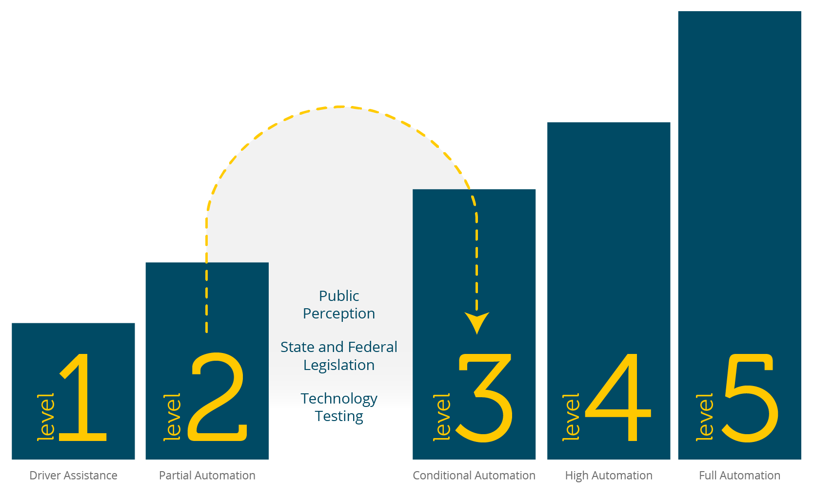
State of the Art
Current commercial products are at most L2 (e.g., Tesla Autopilot)
L2 to L3 is perceived to be a giant leap
Automakers keep pushing the timeline of L3 and above to the future…
Notes:
https://thenextweb.com/shift/2020/02/27/6-levels-autonomous-self-driving-explained-tesla-waymo-autopilot/ https://europe.autonews.com/automakers/lexus-prepares-introduce-level-2-autonomy

Slide 18
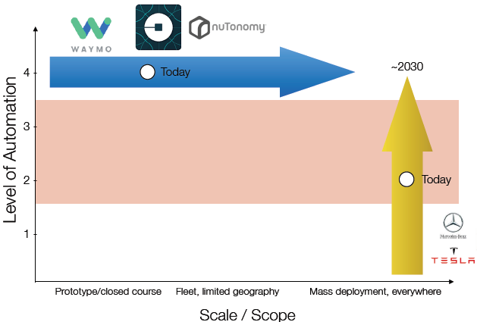
Two Different Paths to L4/5
Tesla starts from L2 and mass deployment, and gradually moves to L4/5.
Waymo, nuTonomy…starts from L4 in limited ODD, and gradually expands deployment
Emilio Frazzoli, nuTonomy

Slide 19
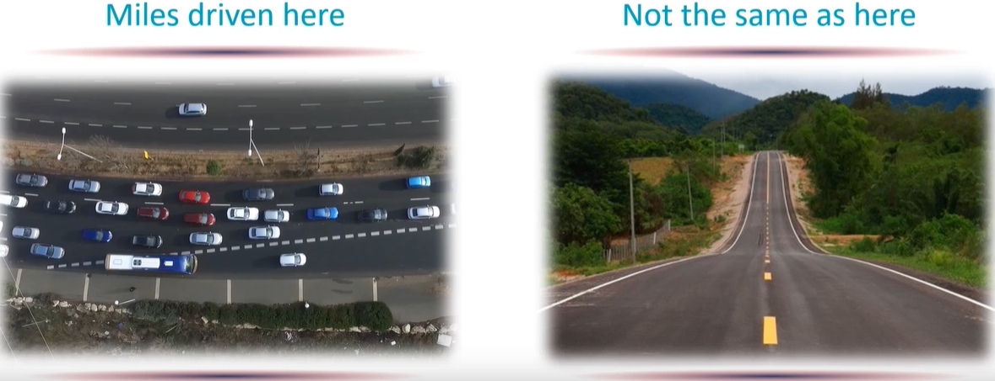
AD Safety Evaluation Metric: Miles Driven?
Not All Miles are Equal.
Driving conditions may be dramatically different.
Companies may be incentivized to avoid difficult driving conditions.

Slide 20
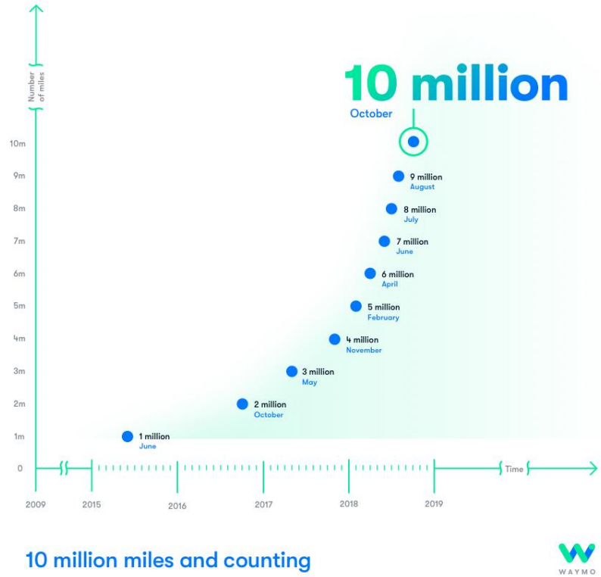
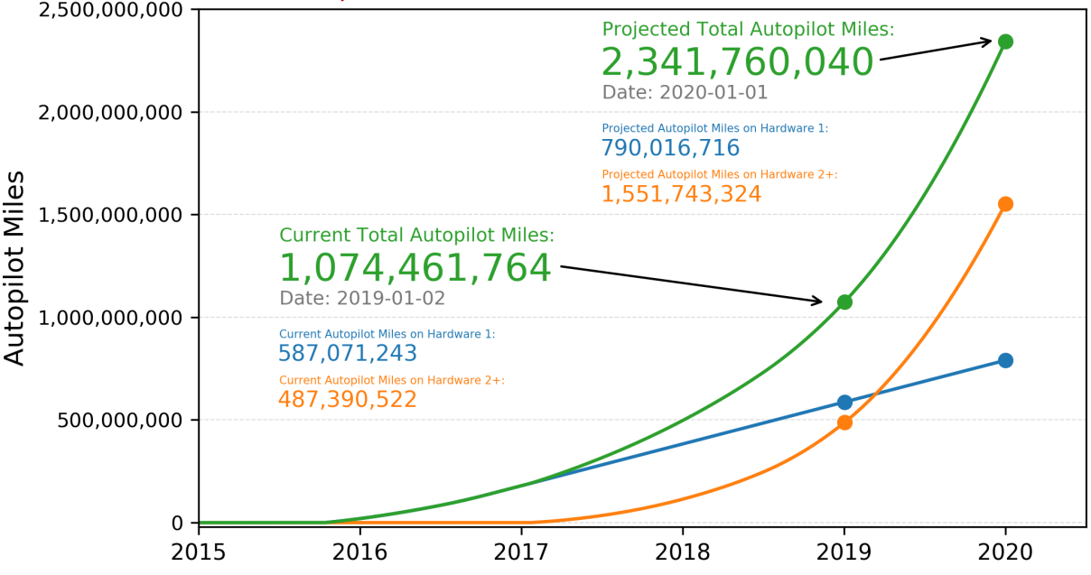
Total Miles Driven
Waymo Reaches 10 Million Miles
Tesla Autopilot Reaches 1 Billion Miles in 2019

Slide 21
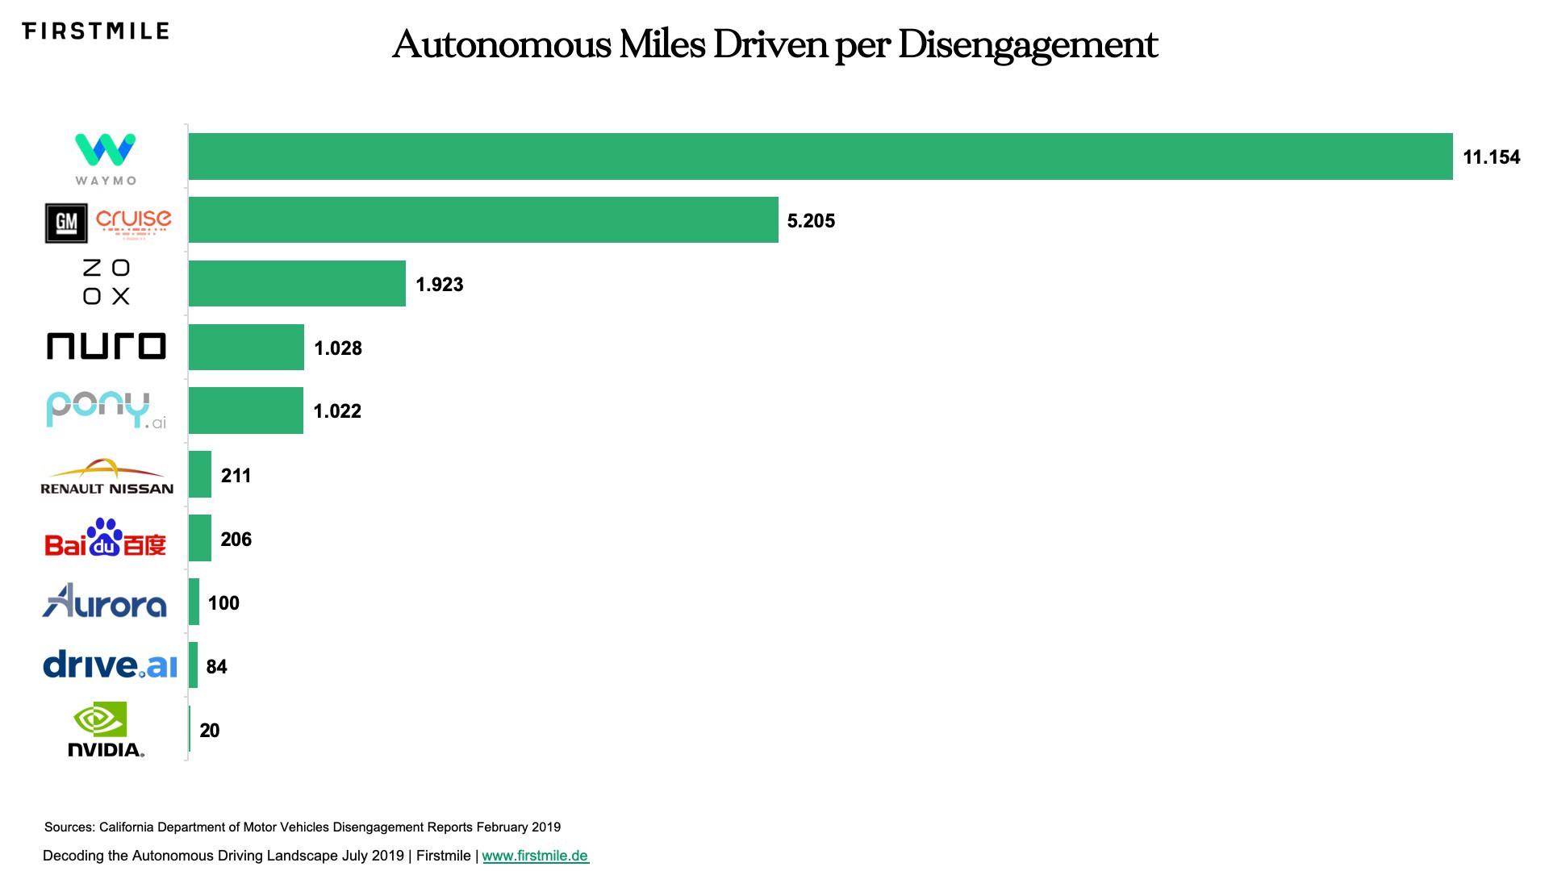
Miles Driven per Disengagement (2018)
The California Department of Motor Vehicles defines a disengagement as a “deactivation of the autonomous mode when a failure of the autonomous technology is detected or when the test driver disengages the autonomous mode.”
There is a lot of disagreement on the level of accuracy of the metric as it may be too vague, is valid only for California, and may not reflect the difficulty of the chosen driving environment.
Notes:
Disengagement is defined as human Vehicle Operator takes over control from AD system.
allows companies to avoid reporting certain road events

Slide 22
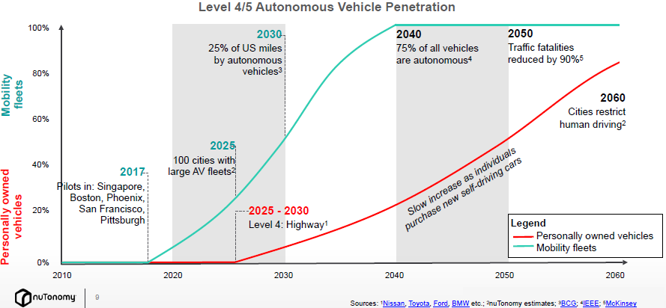
When Will AVs Arrive?
Predictions from 2017
Emilio Frazzoli, nuTonomy

Slide 23
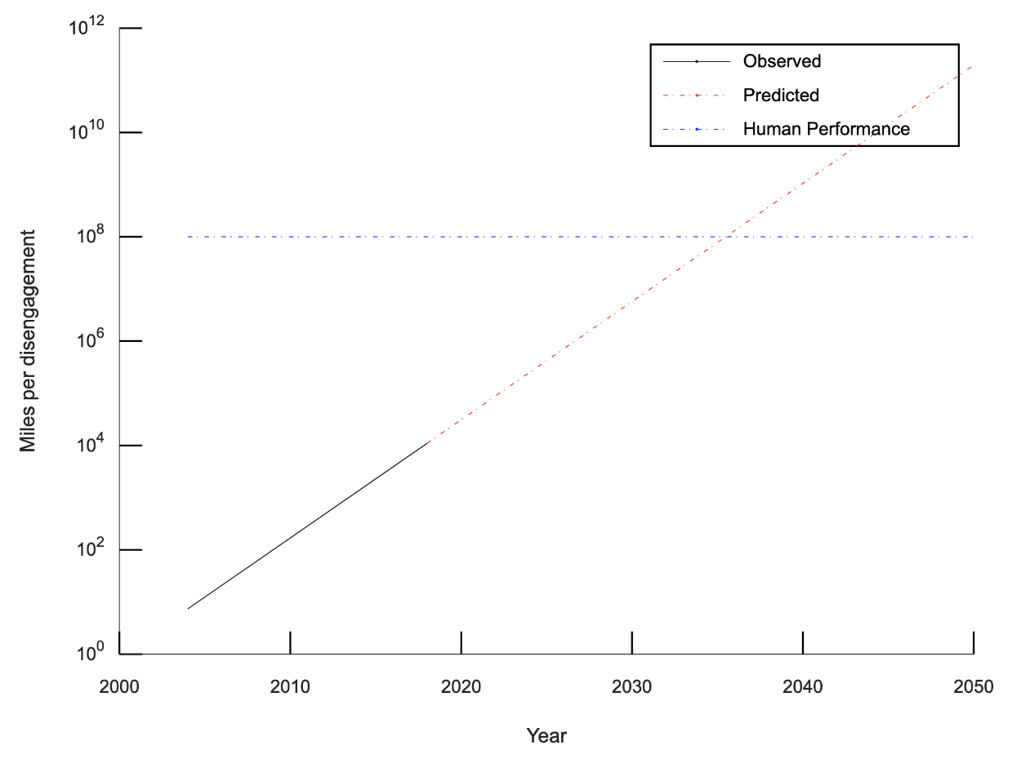
“The Moore’s Law for Self-Driving Vehicles”, Edwin Olson, CEO of May Mobility
Moore’s law in the semiconductor industry says that “the number of transistors on a chip doubles approximately every 18 months”, i.e., w. exponential growth rate
Can we have a Moore’s law for AD? “The number of miles between disengagements will double approximately every 16 months.”
Between human performance (10⁸ miles per fatality) and the best-reported self-driving car performance (10⁴ miles per disengagement) is a gap of 10,000x. Even with performance doubling every 16 months, it will reach human levels of performance in 2035.
https://medium.com/may-mobility/the-moores-law-for-self-driving-vehicles-b78b8861e184

Slide 24
When will AD Really Arrive?
Chris Urmson, co-founder and CEO of Aurora:
“In 5 years” - 2009
“In 5 years” - 2012
“In 5 years” - 2015
“In 5 years” - 2018
Notes:
By that I mean mass deployment without Human Operators to fall back on.

Slide 25
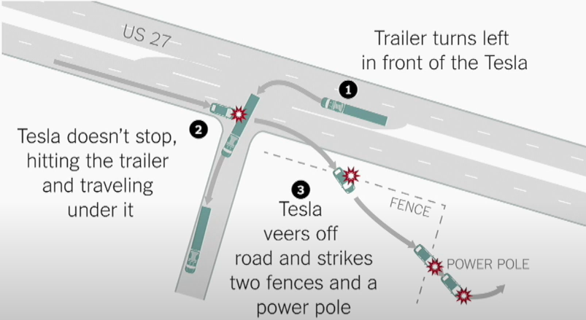
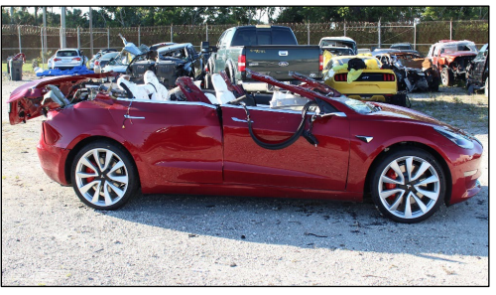
The Tesla Fatality in May 2016
The Tesla Model S (L2) was driving 74 mph on the highway when it was struck by a semitruck
The driver’s hands were off the steering wheel for a total of 37 minutes during the 37.5 minutes of time the car was in Autopilot, despite repeated visual warnings
Tesla: “Neither Autopilot nor the driver noticed the white side of the tractor trailer against a brightly lit sky, so the brake was not applied.”
A failure of computer vision algorithm for object detection; maybe a lidar could have prevented the accident.
Tesla used to use Mobileye’s hardware platform EyeQ, but they broke up after the accident, and Tesla started to develop its hardware platform FSD.
Notes:
https://www.wired.com/story/teslas-latest-autopilot-death-looks-like-prior-crash/
https://www.businessinsider.com/details-about-the-fatal-tesla-autopilot-accident-released-2017-6?r=US&IR=T
NTSB (National Transportation Safety Board)’s report noted the truck driver should have yielded to the Tesla and that the driver was inattentive.

Slide 26
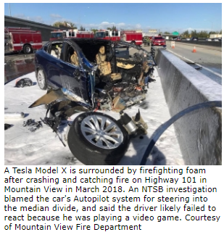
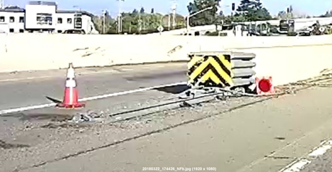
The Tesla Fatality in Mar 2018
In 2018, a man died from a high-speed crash because his Tesla Autopilot system steered the car into a median on Highway 101 in Mountain View, CA.
NTSB’s investigation report, released in Feb 2020, lists 23 findings that enumerate all the factors that contributed to the fatal collision.
Limitations on Tesla's Autopilot Lane-Keeping Assistance (LKA) caused the vehicle to veer into the median and failed to provide an alert to the driver in the seconds leading to the crash.
The collision avoidance system was not designed to detect a crash attenuator, which resulted in a severe crash in which the automatic braking and collision warning systems failed to activate.
The driver was likely playing a video game at the time.
A failure of computer vision algorithm for lane tracking.
https://www.mv-voice.com/news/2020/02/25/ntsb-teslas-autopilot-steered-model-x-into-highway-median-causing-fatal-mountain-view-crash
Notes:
The Model X's collision avoidance system was not designed to detect a crash attenuator and the NHTSA does not require such capability, which resulted in a severe crash in which the automatic braking and collision warning systems failed to activate.

Slide 27
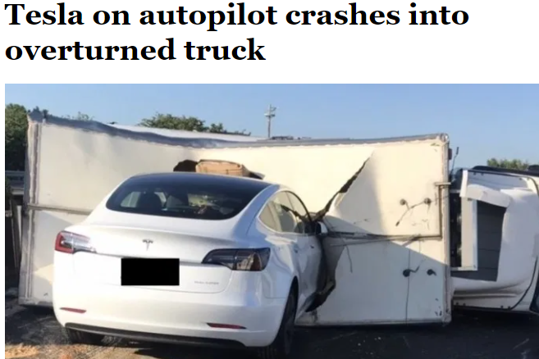
Tesla still cannot recognize white trucks in 2020
Tesla on Autopilot Crashes into Overturned Truck on Busy Highway in Taiwan
https://www.youtube.com/watch?v=X3hrKnv0dPQ

Slide 28
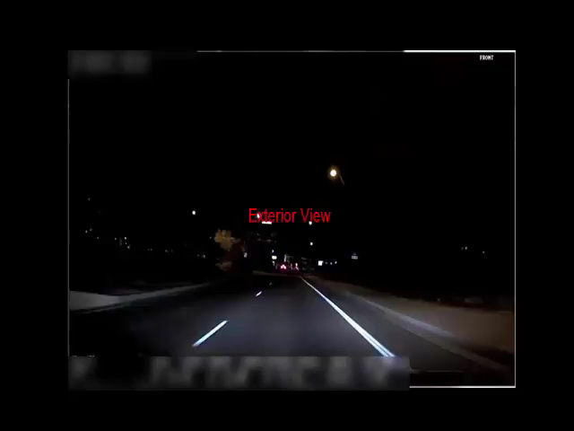
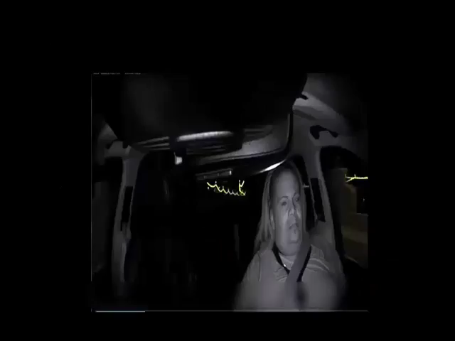
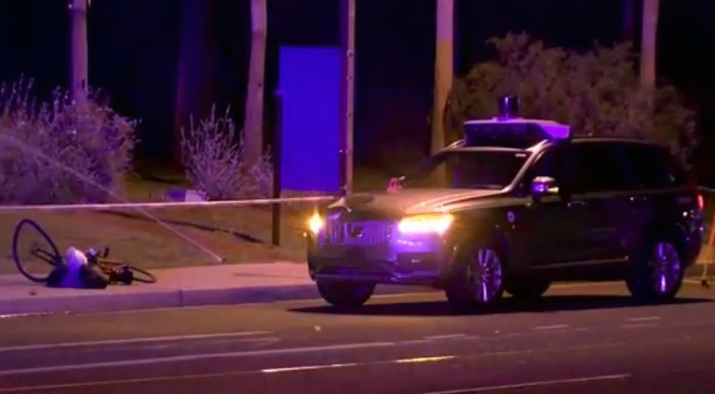
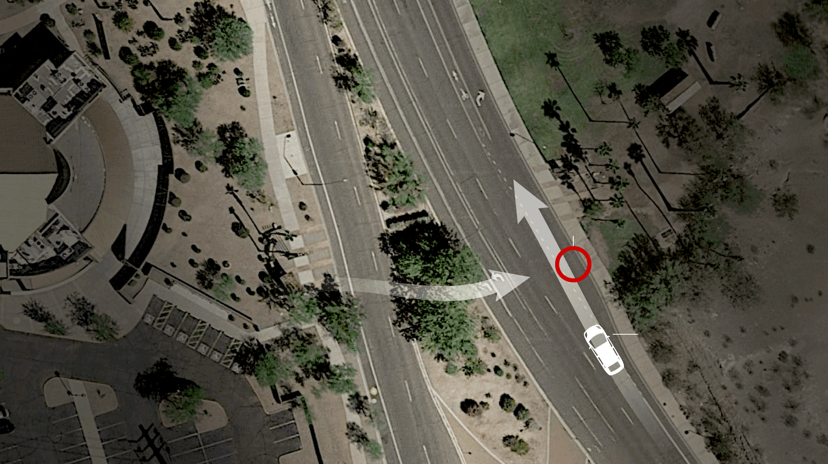
The Uber Pedestrian Fatality in Mar 2018
Notes:
https://www.nytimes.com/interactive/2018/03/20/us/self-driving-uber-pedestrian-killed.html

Slide 29
The Uber Pedestrian Fatality in Mar 2018
The AV (L3/4) was equipped with both Lidar and Radar. After the woman was detected on the road (6 sec before)
first classified as unknown object
then misclassified as a vehicle
then a bicycle
1.3 sec before, the Volvo system tried to do emergency braking maneuver
but Uber had disabled it for testing
The safety driver was not watching the road moments before the vehicle struck her.
It was probably too dark for the driver to see her in time.
Notes:
https://en.wikipedia.org/wiki/Death_of_Elaine_Herzberg David King, an Arizona State University professor: “This is exactly the type of situation that Lidar and radar are supposed to pick up. This is a catastrophic failure that happened with Uber’s technology.”
Ryan Calo, a University of Washington law professor and self-driving expert: “I really don’t understand why Lidar didn’t pick this up. Shadows don’t matter to Lidar. There is no question it should have been able to see her.”
The XC90 as modified by Uber included a single roof-mounted LiDAR sensor and 10 radar sensors, providing 360° coverage around the vehicle. In comparison, the Fusion had seven LiDAR sensors (including one mounted on the roof) and seven radar sensors. According to Velodyne, the supplier of Uber's LiDAR, the single roof-mounted LiDAR sensor has a narrow vertical range that prevents it from detecting obstacles low to the ground, creating a blind spot around the vehicle. Marta Hall, the president of Velodyne commented "If you're going to avoid pedestrians, you're going to need to have a side lidar to see those pedestrians and avoid them, especially at night."

Slide 30
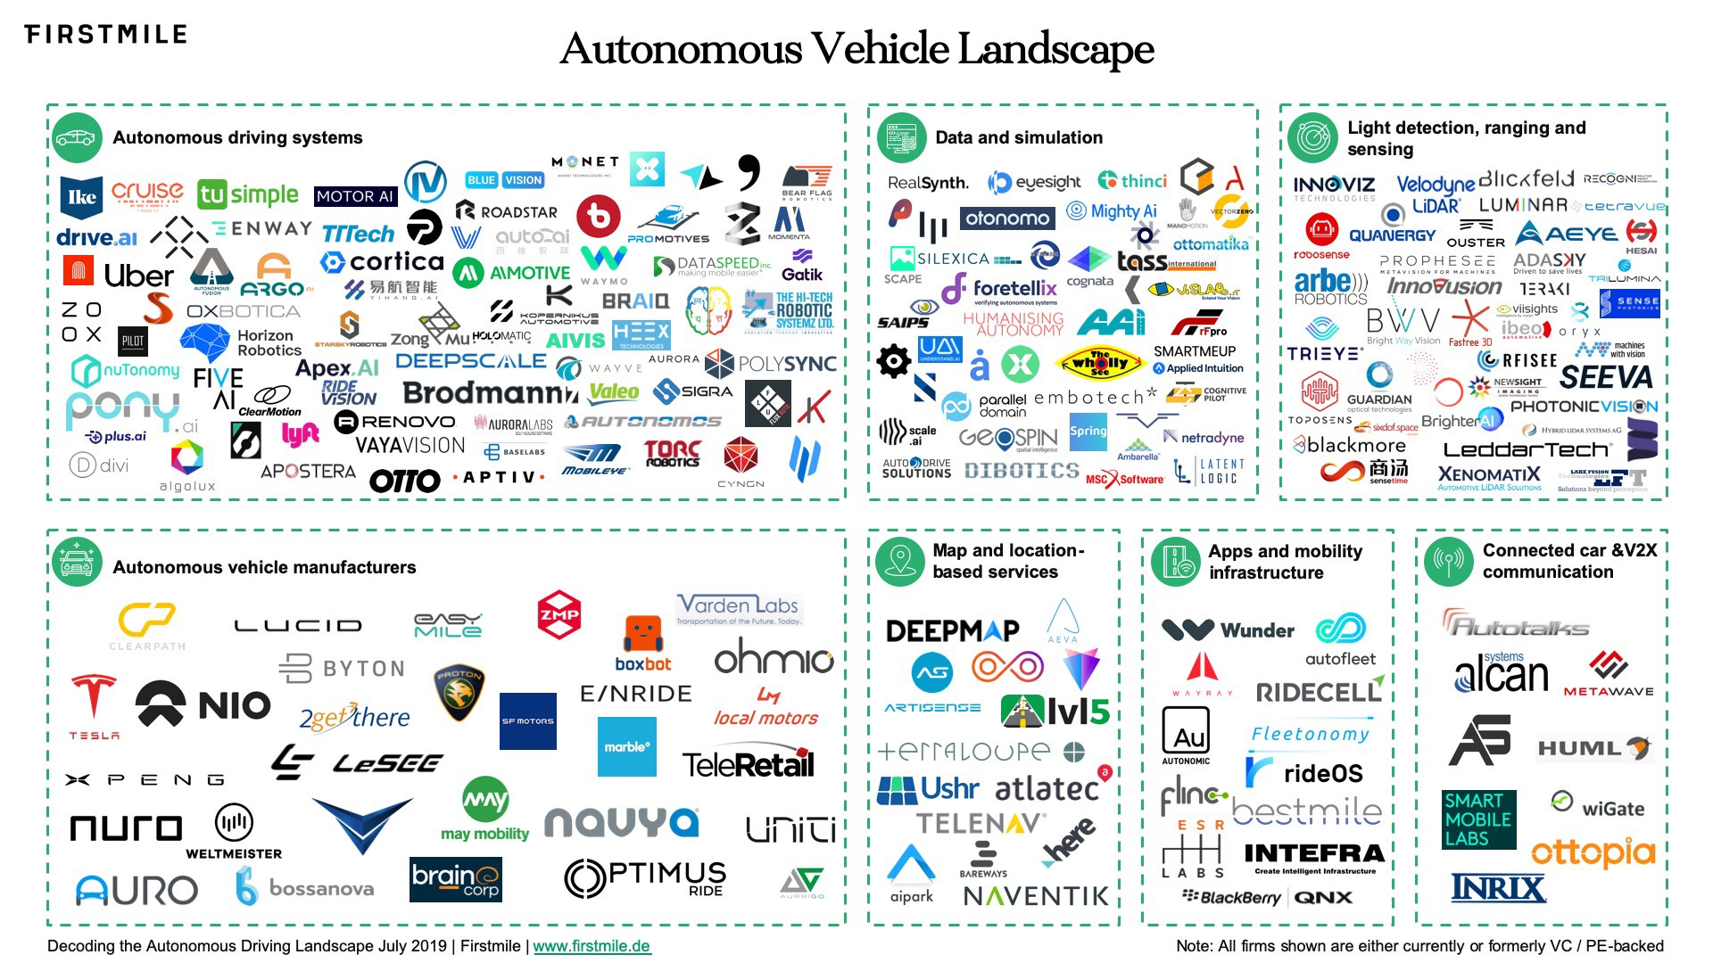
AD Landscape Today
https://medium.com/@firstmilevc/avlandscape-8a21491f1f54

Slide 31
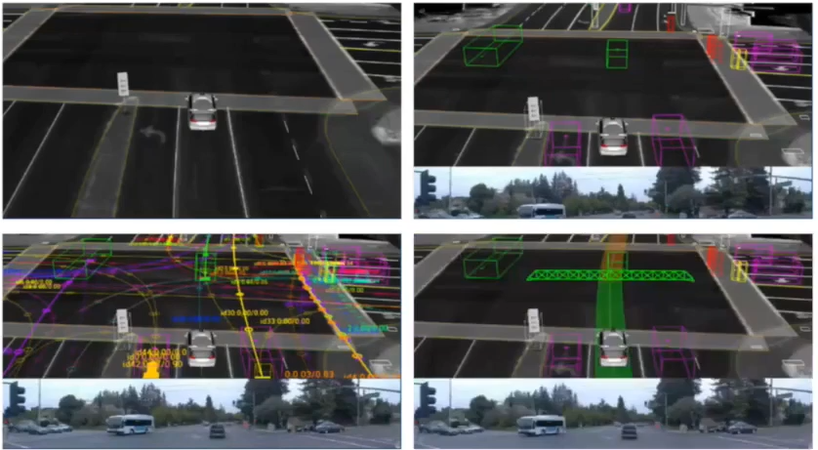
Four Major Tasks of an AV
Localization: Where am I?
Detection: What is around me?
Prediction: Where are they going?
Planning and Control: Where should I go?

Slide 32
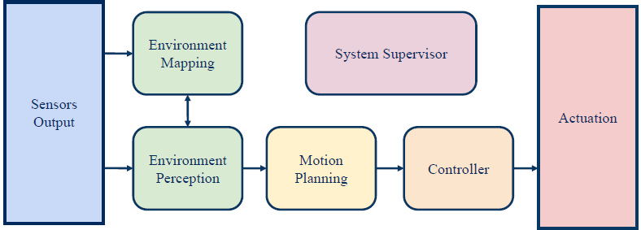
AD Processing Pipeline
Sensing:
Understanding the surrounding environment, incl. localization, detection, prediction
Planning:
Decision making in the context of other road users
Acting:
Moving the car according to the planned trajectory
Notes:
Environment Perception
Environment Mapping
Motion Planning
Controller
System Supervisor

Slide 33
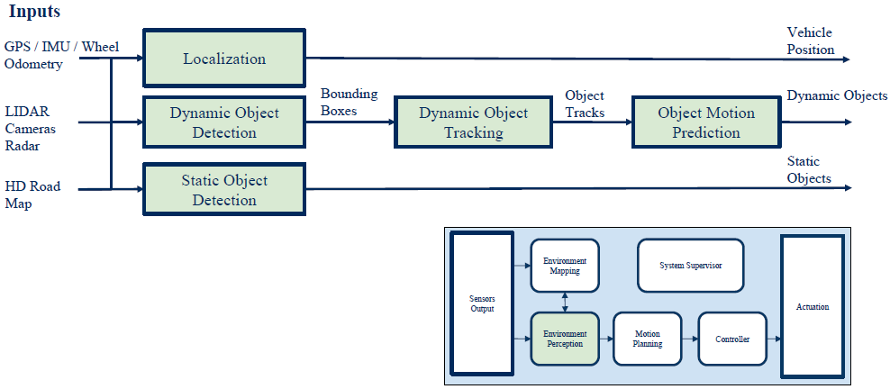
Environment Perception

Slide 34
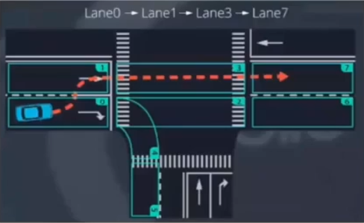
Prediction
Based on state
Kalman filter
Particle filter
Data-driven
ML-based classification
Pedestrian intention prediction
Based on visual cues such as pose, etc.
Very difficult problem

Slide 35
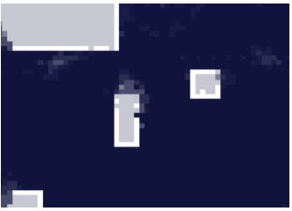
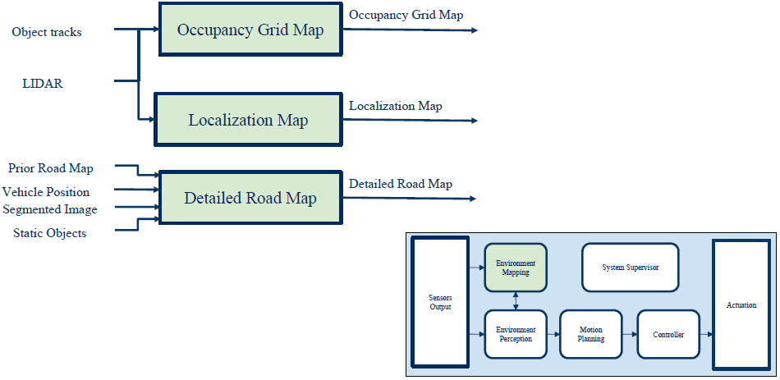
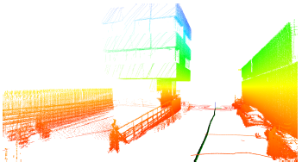
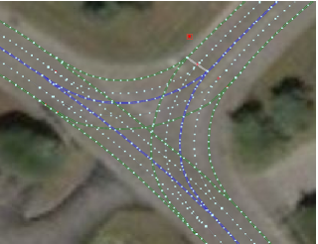
Environmental Maps

Slide 36
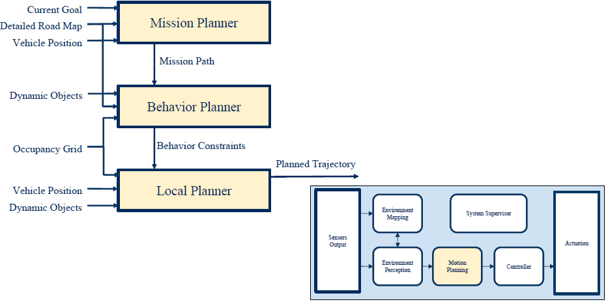
Motion Planning

Slide 37
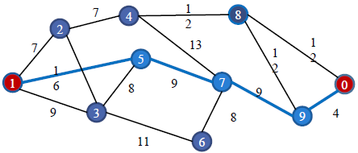
Mission Planner
Use graph search to find a path from source to destination on the map

Slide 38
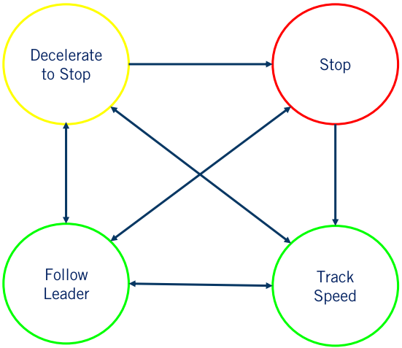
Behavior Planner
Plan the set of high-level driving actions or maneuvers to safely achieve the driving mission under various driving conditions

Slide 39
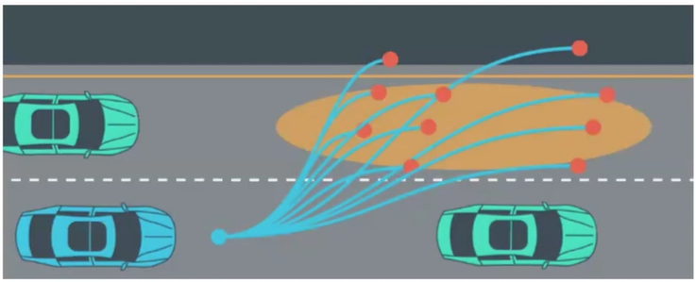
Local Planner
Plan a safe and smooth trajectory (vehicle pose as function of time)

Slide 40
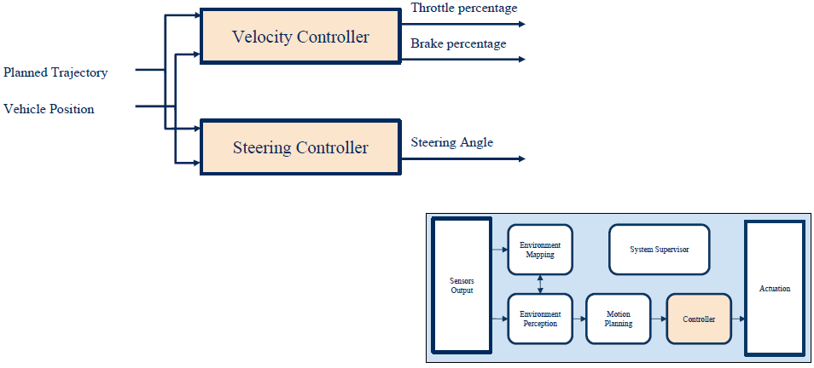
Controller
Velocity controller for longitudinal speed control
Steering controller for lateral speed control
Common control algorithms
PID: Proportional Integral Derivative
MPC: Model-Predictive Control

Slide 41
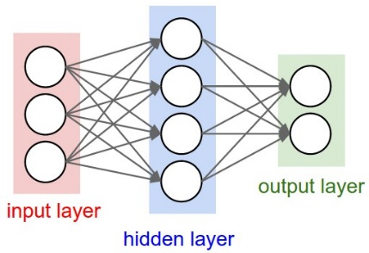
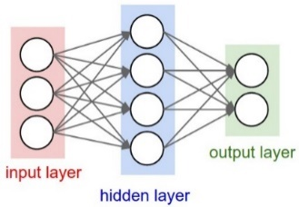
Classic Pipeline vs. ML/DL
Classic AD processing pipeline: separate algorithms for each processing stage.
Where does ML/DL come in?
CNN (Convolutional Neural Networks) for perception is well accepted.
DNN trained with Imitation Learning (IL) or Reinforcement Learning (RL) is still in the early-research stage.
“End-to-end” mapping from pixels to control commands
Many variants of hybrid approaches, e.g., “half-way” mapping from pixels to waypoints used for planning
Several companies are making a bet on it, incl. Waymo, Voyage, Wayve…
Notes:
Perception
e.g., classic Computer Vision algorithms
Decision making
e.g., behavior/path/trajectory planning
Control
e.g., PID, MPC

Slide 42
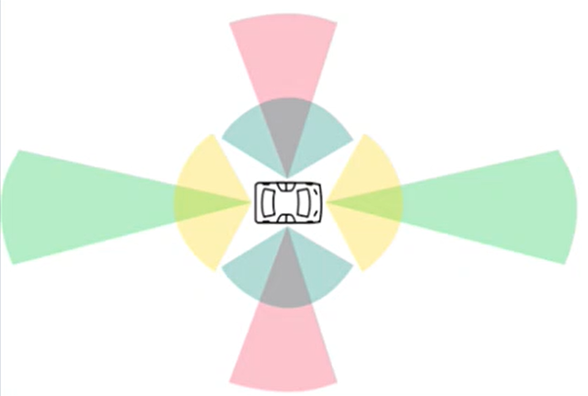
SENSORS AND PERCEPTION

Slide 43
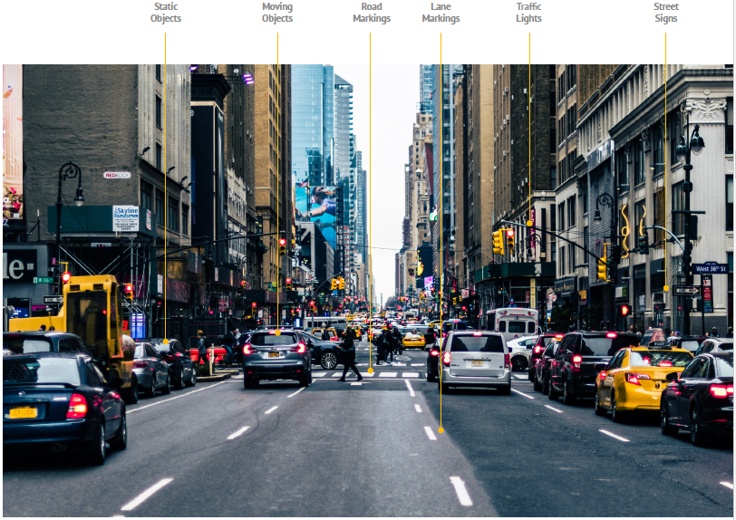
The variety of static and moving objects that an AV needs to detect and recognize

Slide 44
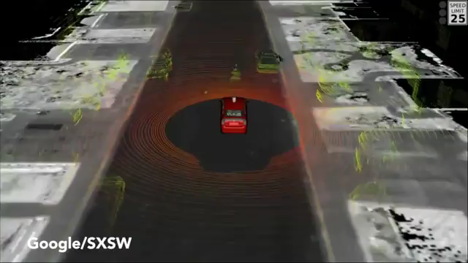
Perception is Challenging
Anything can happen on the road!
Video from 2015, recorded by Google’s AV.

Slide 45
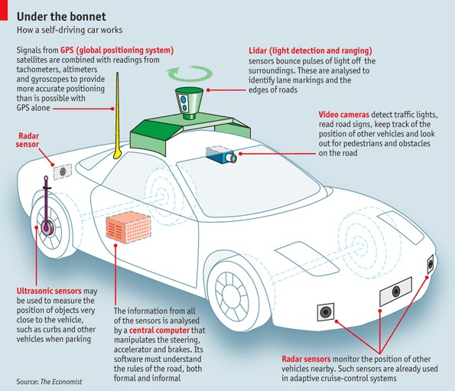
The Typical AV Sensor Configuration
Notes:
Global Positioning System (GPS) • Light Detection and Ranging (LIDAR) • Cameras (Video) • Ultrasonic Sensors • Central Computer • Radar Sensors • Dedicated Short-Range Communications-Based Receiver (not pictured)
https://www.economist.com/the-economist-explains/2015/05/12/how-does-a-self-driving-car-work
Cameras – Provide real-time obstacle detection to facilitate lane departure and track roadway information (like road signs).
Radar – Radio waves detect short & long-range depth.
LIDAR – Measures distance by illuminating target with pulsed laser light and measuring reflected pulses with sensors to create 3-D map of area.
GPS – Triangulates position of car using satellites. Current GPS technology is limited to a certain distance. Advanced GPS is in development.
Ultrasonic Sensors – Uses high-frequency sound waves and bounce-back to calculate
distance. Best in close range.
Central Computer – “Brain” of the vehicle. Receives information from various components and helps direct vehicle overall.
DRSC - Based Receiver – Communications device permitting vehicle to communicate with other vehicles (V2V) using DSRC, a wireless communication standard that enables reliable data transmission in active safety applications. NHTSA has promoted the use of DSRC.

Slide 46
Configuration of Sensors of Some Research AVs
 | Uber | Waymo | GM Cruise | Navya Autonomy Cab | Drive.ai | Nissan | Tesla Autopilot V9
Cameras | 8 | 8 | 16 | 6 | 10 | 12 | 8
Lidars | 1 | 6 | 5 | 10 | 4 | 6 | 0
Radars | 4 | 4 | 8 | 4 | 2 | 9 | 1
Tesla is one of the few AD companies that do not use Lidar.
Elon Musk, 2017: “Once you solve cameras for vision, autonomy is solved; if you don’t solve vision, it’s not solved … You can absolutely be superhuman with just cameras.” “In my view, Lidar is a crutch that will drive companies to a local maximum that they will find very hard to get out of. Perhaps I am wrong, and I will look like a fool. But I am quite certain that I am not.”
Notes:
My opinion: Cameras should be enough, theoretically, since humans drive quite well with their eyes as the only sensor. But in practice, computer vision algorithms are not yet at the level of human visual system (eyes+brain), and Lidar can be very helpful. (I think one reason of not using lidar is to save cost.)

Slide 47
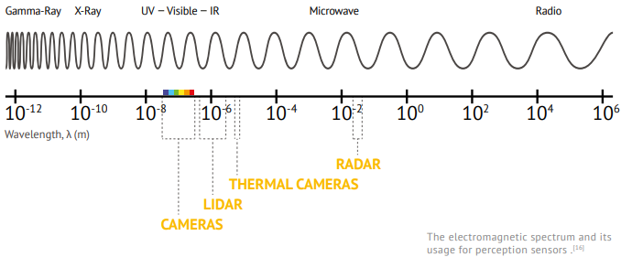
Passive vs. Active Sensors
Passive sensors detect existing energy, like light or radiation, reflecting from objects in the environment.
Cameras
Active sensors (also called range sensors) send their own signal and sense its reflection
Lidar, Radar, ultrasound
https://www.wevolver.com/article/2020.autonomous.vehicle.technology.report

Slide 48
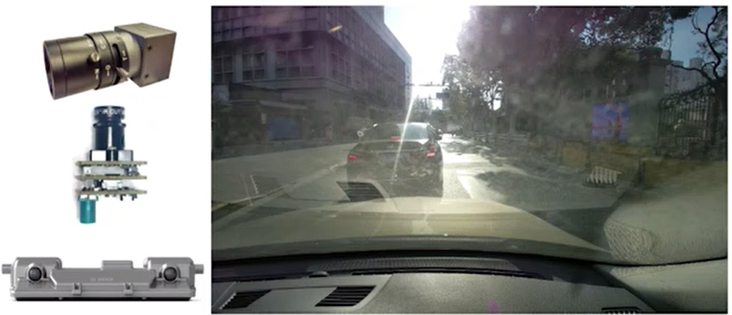
Camera
Pro: cheap, versatile, stereo vision w. two cameras
Con: easily affected by illumination conditions, needs additional light at night
Key parameters
Resolution
e.g.,1080p HD cameras provide 1920x1080-pixel resolution, or 2.1 megapixels.
Field of View (FOV)
The extent of the observable world that is seen at any given moment
Given same resolution, wider FOV results in large image distortion.
Dynamic range
Maximum difference between the darkest and lightest pixel intensities in an image, measured in dB. An AV needs HDR (High-Dynamic-Range) cameras with at least 100dB.
Notes:
The human eye can perceive about 20 stops of dynamic range, i.e, we can perceive $2^{20}=1$ million times darker than the brightest ones in the same scene
The most versatile sensor (main sensing modality of humans).

Slide 49
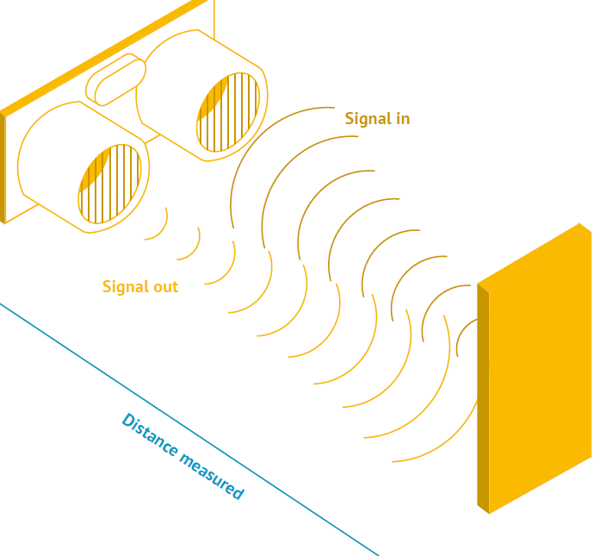
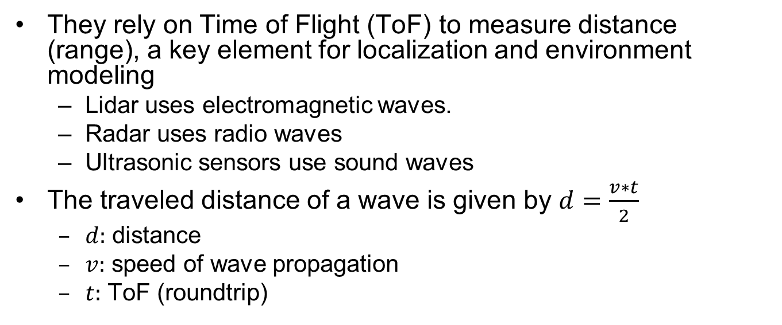
Range Sensors
They rely on Time of Flight (ToF) to measure distance (range), a key element for localization and environment modeling
Lidar uses electromagnetic waves.
Radar uses radio waves
Ultrasonic sensors use sound waves
The traveled distance of a wave is given by $d=\frac{v∗t}{2}$
$d:$ distance
$v:$ speed of wave propagation
$t:$ ToF (roundtrip)

Slide 50
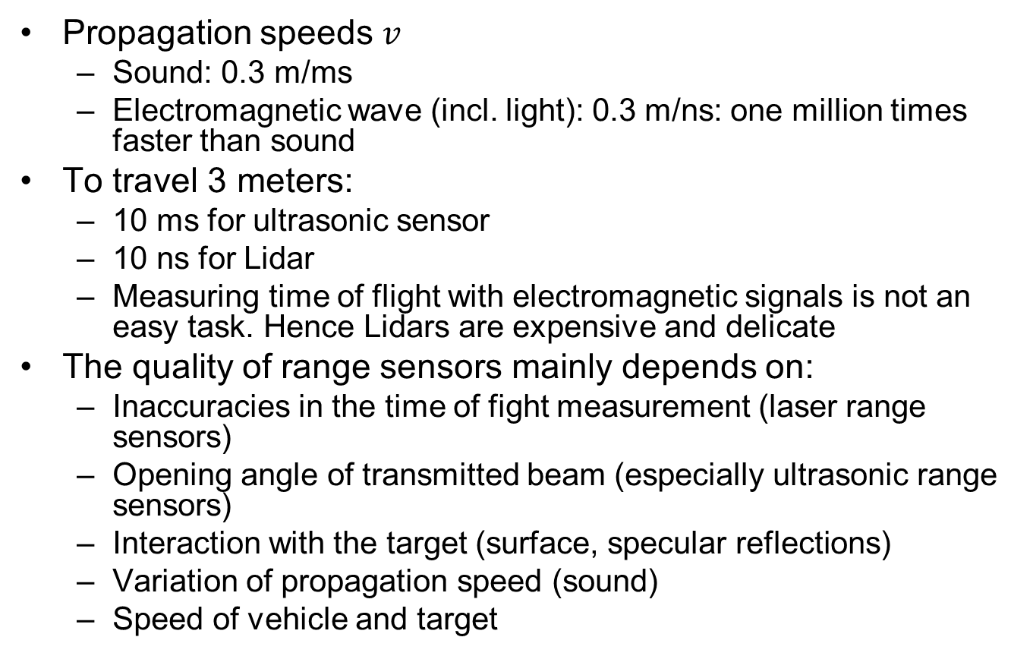
Range Sensors
Propagation speeds $v$
Sound: 0.3 m/ms
Electromagnetic wave (incl. light): 0.3 m/ns: one million times faster than sound
To travel 3 meters:
10 ms for ultrasonic sensor
10 ns for Lidar
Measuring time of flight with electromagnetic signals is not an easy task. Hence Lidars are expensive and delicate
The quality of range sensors mainly depends on:
Inaccuracies in the time of fight measurement (laser range sensors)
Opening angle of transmitted beam (especially ultrasonic range sensors)
Interaction with the target (surface, specular reflections)
Variation of propagation speed (sound)
Speed of vehicle and target

Slide 51
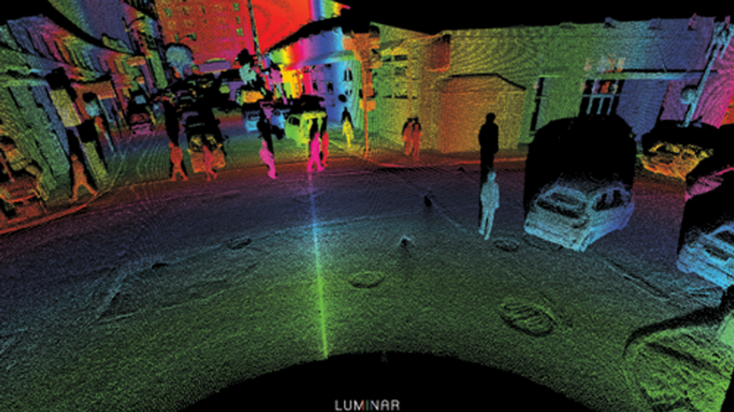

Lidar
Lidar (Light Detection and Ranging Device) sends millions of light pulses per second in a well-designed pattern to generate “Point Clouds” that describe the 3D geometry of the surrounding environment
Pro: independent of lighting conditions, precise distance measurements for 3D perception
Con: expensive, medium resolution
Key parameters:
Laser beam count
Rotation Speed
FOV
Range distance (from tens to hundreds of meters)
Notes:
Figure shows the ideal detection results from a 3D LIDAR, with all the moving objects being identified. . With its rotating axis, it is able to create a dynamic, 3D map of the environment. Point clouds per Second

Slide 52

Velodyne Lidar
The high-end Velodyne HDL-64E with 64 laser emitters
Rotation rate up to 15 Hz
FOV is 360° horizontally and 26.8° vertically
Angular resolution is 0.09° and 0.4° respectively
Delivers ~1.3M data points per second
Expensive (~USD$40-80K) (cheaper versions available)
Notes:
than SICK laser range finders (SICK ~$2-4K, Velodyne Today hundreds of Lidar products are on the market, some with very low prices.
The distance accuracy is better than 2 cm and can measure depth up to 50 m
Its position on top of the car increases air resistance and reduces mileage (maybe a minor concern).

Slide 53

Many Variants of Lidars in the Market
http://www.f4news.com/2018/05/04/yole-on-lidar-market/

Slide 54

Apple iPAD Pro has Built-in Lidar (2020)
It allows users to scan a depth-accurate depiction of the environment.
Main application: Augmented Reality (AR)
Needs depth information to place virtual objects in the environment.
Notes:
it allows users to scan a depth-accurate depiction of their surroundings

Slide 55

mmWave Radar
Pro: provides both position and relative speed information
Con: low resolution
Key parameters
Sensing distance
FOV
Position and velocity accuracy
Two types
Short-medium range with wide FOV
Long range with narrow FOV
Notes:
For accurate target detection and relative speed measurement (main sensing modality of bats)

Slide 56

Ultrasound
Pro: not affected by lighting conditions, rain or fog
Con: short sensing range (mainly used for parking assistance)
Key parameters
Sensing range
FOV

Slide 57

Comparison of Sensing Ranges
https://www.wevolver.com/article/2020.autonomous.vehicle.technology.report

Slide 58
Other Comparisons
Each sensor has its strengths and weaknesses
Sensor fusion crucial for robust perception
 | Camera | Lidar | Radar
Sensing Range | Mixed | Mixed | Good
Functioning in bad weather | Poor | Mixed | Good
Functioning in poor lighting | Mixed | Good | Good
Object Detection | Mixed | Good | Mixed
Object Classification | Good | Mixed | Poor
Lane Tracking | Good | Poor | Poor

Slide 59

GNSS/GPS
GNSS (Global Navigation Satellite System) provides localization service for outdoor applications. Current GNSS systems include:
GPS (USA), Galileo (Europe), Beidou (China), GLONASS (Russia)
Conventional GPS provides a few meters accuracy, affected by cloud covers and tall buildings; RTK (Real-Time Kinematic) GPS can provide centimeter-level accuracy by calculating and transmitting differential correction data via radio to allow the roving GPS system (vehicle) to correct its position

Slide 60


IMU
IMU (Inertial Measurement System) measures acceleration (linear and angular) and orientation (yaw, pitch, roll)
For ground vehicles on 2D plane, only yaw is relevant.
For aerial vehicles in 3D space, all three are relevant
Often combined with GNSS/GPS to form INS (Integrated Navigation System), using sensor fusion to achieve higher estimation accuracy
Notes:
It uses gyroscopes and accelerometers to estimate the relative position (x, y, z), orientation (roll, pitch, yaw), velocity, and acceleration of a moving vehicle with respect to an inertial frame
After long periods of operation, drifts occurs; need external reference to cancel it
Kalman Filter, Particle Filter…

Slide 61

Wheel Odometer
Measures the distance traveled by counting the number of wheel rotations, and multiplying it with the tire circumference
Accuracy affected by:
Slippery road surface (which causes tire to move without rotation)
Severely worn tires (which affects tire circumference)

Slide 62

Perception Tasks
4 main perception tasks
Detection
Detect the existence of an object in the environment
Classification
Identify what the object is, e.g., traffic sign, traffic light, pedestrian
Tracking
Track a moving object across time
Segmentation
Semantic segmentation: classify each pixel to its semantic category, e.g., road, car, sky…
Instance segmentation: classify each pixel to an object instance, e.g., car1, car2…

Slide 63

Mobileye's Autonomous Car What the System Sees
Notes:
https://www.youtube.com/watch?v=jKfwHsHUdVc

Slide 64

AV Sensors Generates Big Data
Cameras and Lidars generate the most amount of data.
Sensor data must to be processed in real-time by perception algorithms.
https://datacenterfrontier.com/autonomous-cars-could-drive-a-deluge-of-data-center-demand/
Notes:
Cameras: ~20-40 MB/s
Lidars: ~10-70 MB/s
Radars: ~10-100 KB/s
Sonars: ~10-100 KB/s
GPS: ~50 KB/s
An AV can generate ~4TB/day sensor data that must be processed in real-time

Slide 65

High-Definition (HD) Maps

Slide 66

HD Maps
Different from navigation maps (e.g., Google Maps) designed for human eyes, HD maps are designed for processing by computers
Highly-accurate (centimeter-level) 3D representation of the road network, e.g., cross section layout; locations of traffic lights/signs; semantic information on certain road segments (speed limits…)
Benefits
Help reduce Region-of-Interest (ROI) for detection of traffic elements
Help with AV localization based on known object positions
help with recognition of lane center line

Slide 67
Are HD Maps Necessary?
Humans don’t need HD maps to drive
HD maps vs. on-board sensing
Use of HD maps limits the area of operation; mapless systems allow universal operation anywhere.
Use of HD maps reduces the computational burden on on-board sensing: the more that has already been mapped out, the easier it is for the on-board system to focus on the moving parts; mapless systems must figure out everything on-the-fly with no prior knowledge of the environment
It is generally agreed that L4-L5 levels of automation cannot work without HD maps, at least for now; L2-L3 levels may work without them (e.g., Tesla does not use HD maps)

Slide 68

HARDWARE PLATFORMS

Slide 69

Typical Automotive E/E Architecture
Ethernet as high-bandwidth backbone network
Ethernet TSN posed to be the dominating standard protocol.
Regular Ethernet is also used for diagnostics
FlexRay for safety-critical X-by-Wire, where X stands for brake, steer, drive…
Gradually being replaced by Ethernet
Media Oriented Systems Transport (MOST) for multimedia transmission
Gradually being replaced by Ethernet
CAN (Controller Area Network) for low-bandwidth network and interfacing with sensors/actuators
LIN (Local Interconnect Network) for body electronics, e.g., door, light, rearview mirrors…
https://www.renesas.com/eu/en/solutions/automotive/technology/networking-solutions.html
Notes:
In-Vehicle Networking

Slide 70

Evolution of Automotive E/E Architecture
From many (~80-100) distributed and networked ECUs to a few (~4) high-performance ECUs with massive computing power, and large number of (~60) small ECUs for interfacing with sensors and actuators.
This helps simplify system architecture, reduce network load, and improve system reliability.
Notes:
https://www.st.com/content/ccc/resource/sales_and_marketing/presentation/product_presentation/group0/02/cb/7a/e7/8d/aa/40/1e/China_STM_MCU_Techincal_Day_5_Elektrobit_AUTOSAR_Introduction/files/China_STM_MCU_Techincal_Day_5_Elektrobit_AUTOSAR_Introduction.pdf/jcr:content/translations/en.China_STM_MCU_Techincal_Day_5_Elektrobit_AUTOSAR_Introduction.pdf

Slide 71


Trunk of an Experimental AV from Ford (2017)
Where do I put my groceries?
https://www.theverge.com/2017/10/10/16449416/nvidia-pegasus-self-driving-car-ai-robotaxi

Slide 72
AD Hardware Considerations
Power consumption
Power consumption of electronics (sensors and computing hardware) for AD may be 100x that of a vehicle with regular ADAS. This drains battery and implies increased fuel consumption or reduced range for EVs
EV drivers often turn off air conditioning due to range anxiety; will they turn off AD and drive manually for this reason?
Waymo and Ford now focus on Hybrid Vehicles, while Uber uses a fleet of full gasoline SUVs.
Cooling capacity
Fan or liquid cooling.
Form factor
Must be compact and unobtrusive.
Cost
Important for mass deployment.
Cost of electronics in an experimental AV often exceeds cost of the original vehicle.
Notes:
Performance of limited form factor, power consumption and cooling capacity.
Must achieve high performance under constraints
Real-time processing of sensor data
HW resource
Due to cost/power/thermal constraints
(some estimate it to be 2.5KW)

Slide 73
SoC Hardware for AVs
The most compute-intensive workload is Deep Learning
Mostly inference tasks, but may also perform training tasks in case of online-learning.
Many vendors provide SoC (System-on-Chip) products that integrate CPU cores with specialized computational engines for Deep Learning:
GPU (Graphics Processing Unit)
NVIDIA is the only serious player.
Other GPU venders, e.g., AMD, ARM, Intel, focus on computer graphics instead of general-purpose computing (GPGPU).
FPGA (Field-Programmable Gate Arrays)
Xilinx, Intel Altera
ASIC (Application-Specific Integrated Circuit)
An explosion of specialized ASICs for Deep Learning in recent years, with hundreds of companies and products ranging from high-performance to embedded.
DSP (Digital Signal Processor)
Mainly for image preprocessing, e.g., products from Texas Instruments.

Slide 74

CPU vs. GPU
GPU has much simpler control logic than CPU, hence has more computational elements (Arithmetic Logic Units)
GPU is ideally suited for processing highly-parallel workloads
e.g. matrix-multiply, which is a core operation in Deep Learning algorithms

Slide 75


CPU vs. GPU
When you are plowing a field, would you prefer 4 strong oxen (a multicore CPU), or 1024 chickens (a GPU)?
Similar arguments for FPGAs (Field-Programmable Gate Arrays) and ASICs (Application-Specific Integrated Circuits)

Slide 76

NVIDIA DRIVE Hardware
A family of products, ranging from the low-end Parker to the latest high-end ORIN with 200 TOPS (Tera Operations Per Second), announced in Dec 2019.
Besides CPU and GPU cores, also includes NVDLA (NVIDIA Deep Learning Accelerator), an ASIC for Deep Learning inference.
https://www.forbes.com/sites/tiriasresearch/2019/12/18/nvidia-announces-new-orin-auto-ai-processor/
Notes:
https://devblogs.nvidia.com/jetson-xavier-nx-the-worlds-smallest-ai-supercomputer/
Xavier is claimed to be “the world’s first processor designed for autonomous driving.”
https://www.forbes.com/sites/tiriasresearch/2019/12/18/nvidia-announces-new-orin-auto-ai-processor/
, to the low-end Jetson Xavier NX (shown below) with 21 TOPS under 15W of power, or up to 14 TOPS of under 10W.

Slide 77

FPGAs
FPGA is reprogrammable hardware, consisting of an array of Configurable Logic Blocks (CLBs) and interconnections which can be configured at design time or runtime.
Notes:
https://www.researchgate.net/publication/290929451_Field_Programmable_Gate_Array_FPGA_From_Conventional_to_Modern_Architectures/figures?lo=1

Slide 78

FPGA vs. GPU
FPGA has advantages over GPU for Deep Learning inference tasks.
GPU performs computation in batches for efficient exploitation of SIMD computation model.
This is ideally suited for training tasks, with well-known algorithms such as Stochastic Gradient Descent with mini-batches.
But not ideal for inference tasks.
Larger batch size leads to high throughput, but also high and nondeterministic latency for each data item.
Smaller batch size leads to low computation efficiency.
FPGA can perform “batch-less” inference
Low and deterministic latency for any batch size.
https://www.eetimes.com/where-do-fpgas-stand-in-auto-ic-race/#

Slide 79

FPGA for Automotive
FPGAs can be integrated into sensors (camera, Lidar, radar), or serve as central compute engine in domain controller or AD computer
Xilinx FPGAs have 90% market share in lidars.
Intel is pushing hard into the automotive market, with acquisition of Altera in 2015.
https://www.xilinx.com/applications/automotive/automated-driving.html

Slide 80
ASICs
ASICs for Deep Learning are often called Neural Processing Units or AI accelerators.
ASICs, thanks to dedicated circuit design, may achieve up to 10x in computation efficiency and power consumption compared to CPU/GPU, and less dramatic, but still significant improvement compared to FPGA. The drawback is loss of programmability and flexibility.
Industry: almost every chip vendor provides some kind of AI accelerator, too many to list here.
Academia: AI accelerators is a dominating topic in top conferences in computer architecture, including ISCA, MICRO and HPCA.

Slide 81


MobileEye EyeQ Series
“Computer Vision Processors” are ASICs
https://www.mobileye.com/our-technology/evolution-eyeq-chip/
Notes:
https://www.mobileye.com/our-technology/evolution-eyeq-chip/

Slide 82



Tesla FSD
Full Self-Driving Chip (FSD) is designed by Tesla and introduced in early 2019 for their own cars.
It incorporates 3 quad-core Cortex-A72 clusters for a total of 12 CPUs operating at 2.2 GHz, a GPU operating 1 GHz, 2 Neural Processing Units (NPUs) operating at 2 GHz, and various other hardware accelerators.
NPU: ASIC for Deep Learning inference

Slide 83
Products from Automotive OEMs and Suppliers
These companies do not design chips. Rather, they offer integration solutions based on products from chip vendors like NVIDIA.
Delphi/Audi zFAS (zentrales Fahrerassistenz-Steuergeraet)
based on NVIDIA Tegra K1 and Mobileye EyeQ3
Hedging their bet on products from two mortal enemies ☺
ZF ProAI
based on NVIDIA DRIVE PX2
Bosch AI Car Computer
based on NVIDIA DRIVE AGX Xavier
Continental ADCU; Visteon DriveCore; NXP BlueBox; Renesas R-Car…

Slide 84

SOFTWARE PLATFORMS

Slide 85

The AUTOSAR Consortium
AUTomotive Open System ARchitecture (AUTOSAR) is a global development partnership of automotive interested parties founded in 2003. It pursues the objective to create and establish an open and standardized software architecture for automotive Electronic Control Units (ECUs).
Notes:
https://medium.com/@autonom/autosar-fundamentals-what-is-autosar-part-1-ac6198c4b075

Slide 86

AUTOSAR Classic Platform
Notes:
https://www.nxp.com/design/automotive-software-and-tools/autosar-/autosar-4-3-x-classic-platform-software:AUTOSAR-4-3 https://www2.informatik.uni-erlangen.de/teaching/thesis/download/i2S00428.pdf

Slide 87

AUTOSAR Adaptive Platform
AUTOSAR-AP is an industry standard that specifies standard interfaces required for developing future automotive ECUs (Electronic Control Units) running on state-of-the-art multicore processors.
Compared to Classic AUTOSAR for resource-constrained safety-critical ECUs, AUTOSAR-AP is designed for high-performance ECUs, and allows dynamic linking of services and clients during ECU runtime, which facilitates Over-the-Air (OTA) Update.
Notes:
These interfaces allow OEMs, as in the car manufacturers, to implement AD, over-the-air software updates, IoT (Internet of Things) features, media streaming and other services to their future cars.

Slide 88

Integration of Multiple Software Platforms
AUTOSAR CP (labeled C) is used for safety-critical ECUs for low-level control and interfacing with actuators
AUTOSAR AP (labeled A) is used for high-performance AD computer.
Non-AUTOSAR (labeled N) may be Linux or Android, for non-safety-critical IVI (In-Vehicle Infotainment) and COTS (Commercial Off-the-Shelf) applications.
Notes:
https://www.autosar.org/fileadmin/user_upload/standards/adaptive/17-03/AUTOSAR_EXP_PlatformDesign.pdf

Slide 89


Robot Operating System (ROS)
ROS is a set of software libraries and tools for building robotic applications. Many companies use ROS to develop AVs. It uses the publish-subscribe paradigm for inter-node communication.
ROS has a Master node that provides naming and registration services to the rest of the nodes.
ROS 2 removed the Master node, and uses publish-subscribe middleware DDS (Data Distribution Service).
A drawback of ROS compared to AUTOSAR:
Since ROS uses Linux as the OS, it is not possible to pass high-level of safety certification (ASIL-D).
Subsystems with different safety criticality levels integrated together form a Mixed-Criticality System.
Maruyama Y, Kato S, Azumi T. Exploring the performance of ROS2[C]//Proceedings of the 13th International Conference on Embedded Software. 2016: 1-10.
Notes:
https://maker.pro/ros/tutorial/robot-operating-system-2-ros-2-introduction-and-getting-started https://www.esol.com/embedded/ros.html Right figure shows integration of ROS, ROS 2, AUTOSAR on top of a Real-Time Operating System eMCOS.

Slide 90

Apex.OS
“Safe and certified software framework for autonomous mobility systems.”
Aims to be certified as a Safety Element out of Context (SEooC) up to ASIL D.
Built on top of ROS2, with modifications:
Hard real-time, static memory allocation (no new() or malloc()), callbacks vs. waitset, security, testing, real-time I/O logging…
QNX is a Real-Time Operating System (RTOS).

Slide 91

EB corbos
EB corbos is an example software platform that uses virtualization technology (hypervisor) to integrate AUTOSAR AP, CP and non-AUTOSAR OS on a single multicore ECU, while achieving high degree of isolation between different Virtual Machine partitions, including:
Performance Partitions with complex Performance Cores for high-performance, subject to low-levels of safety certification
Safety Partition with simpler Safety Cores for safety-critical functions, subject to high-levels of safety certification
Security Partition with processor security extensions (e.g., ARM TrustZone, Intel Software Guard Extensions (SGX)) for secure boot, crypto operations, etc.

Slide 92

NVIDIA DRIVE Software
Notes:
https://developer.nvidia.com/drive/drive-software https://gigazine.net/gsc_news/en/20190319-nvidia-self-driving-cars/

Slide 93
NVIDIA DRIVE
An open-source framework for AD (only for NVIDIA hardware).
DRIVE OS is a foundational software stack consisting of an embedded Real Time OS (RTOS), hypervisor, CUDA libraries, Tensor RT, and other modules that give you access to the hardware engines.
DriveWorks SDK enables developers to implement AV solutions by providing a comprehensive library of modules, developer tools, and reference applications.
DRIVE AV provides perception, mapping, and planning modules that utilize the DriveWorks SDK.
DRIVE IX provides full cabin interior sensing capabilities needed to enable AI cockpit solution.

Slide 94

Baidu Apollo
An open-source, hardware-neutral AD platform from China.
Initially based on ROS, but later replaced ROS with their own components.
Real-Time Operating System (RTOS); Linux kernel with real-time patch
Cyber RT: lightweight, high-performance communication middleware

Slide 95


Autoware
Open-source AD platform from Japan.
Autoware.AI (https://www.autoware.ai) is based on ROS-1.
Autoware.auto (https://www.autoware.auto) is the new version based on ROS2.
Notes:
Nagoya University.
Today, Autoware.AI is supported by the largest autonomous driving open source community with 2300+ stars on GitHub and 500+ accounts on Slack (10/2018).
Autoware.AI has found widespread and international adoption as it is used by more than 100 companies and runs on more than 30 vehicles in more than 20 different countries.
Courses using Autoware are offered in 5 countries.
Automotive OEMs are using Autoware for Mobility as a Service (MaaS) development.
Autoware is qualified to run on

Slide 96

ETHICAL ISSUES

Slide 97
Two Introductory Videos
The ethical dilemma of self-driving cars - Patrick Lin
https://www.youtube.com/watch?v=ixIoDYVfKA0
Moral Machines: How culture changes values
https://www.youtube.com/watch?v=jPo6bby-Fcg

Slide 98

The Trolley Problem
There is a runaway trolley barreling down the railway tracks. Ahead, on the tracks, there are five people tied up and unable to move. The trolley is headed straight for them. You are standing some distance off in the train yard, next to a lever. If you pull this lever, the trolley will switch to a different set of tracks. However, you notice that there is one person on the side track. You have two options:
Do nothing and allow the trolley to kill the five people on the main track.
Pull the lever, diverting the trolley onto the side track where it will kill one person.
What is the right thing to do?

Slide 99

Variants of the Trolley Problem
The fat man
A trolley is hurtling down a track towards five people. You are on a bridge under which it will pass, and you can stop it by putting something very heavy in front of it. As it happens, there is a very fat man next to you – your only way to stop the trolley is to push him over the bridge and onto the track, killing him to save five
The fat villain
The fat man is the villain who put these five people in peril
The loop
A trolley is hurtling down a track towards five people and you can divert it onto a secondary track, which later rejoins the main track, so diverting the trolley still leaves it on a track which leads to the five people. But, the person on the secondary track is a fat person who, when he is killed by the trolley, will stop it from continuing on to the five people
The death of the one actually is part of the plan to save the five. If we fail to act we will effectively be allowing the five to become a means to save the one
The man in the yard
A trolley is hurtling down a track towards five people. You can divert its path by colliding another trolley into it, but if you do, both will be derailed and go down a hill, and into a yard where a man is sleeping in a hammock. He would be killed.

Slide 100


Variant of Trolley Problem with a Probability Threshold
You are in a situation where:
A. you kill a pedestrian with probability 1, but it’s not your fault
B. you kill a different pedestrian with probability $p$, and it is your fault
What is your threshold value $p_{th}$for making the choice?
if($p≥p_{th}$) choose A; otherwise choose B
jaywalker
Pedestrian on sidewalk

Slide 101

MIT Moral Machine Experiment
A 2016 survey indicates that people wanted an autonomous vehicle to protect pedestrians even if it meant sacrificing its passengers — but also that they wouldn’t buy self-driving vehicles programmed to act this way. This prompted the MIT Moral Machine Experiment, a platform for gathering a human perspective on moral decisions made by machine intelligence, such as AVs (http://moralmachine.mit.edu/)
An AV must choose between killing two passengers or five pedestrians. An AV experiences a sudden brake failure. Staying on course would result in the death of two elderly men and an elderly woman who are crossing on a ‘do not cross’ signal (left). Swerving would result in the death of three passengers: an adult man, an adult woman, and a boy (right).
You can also design other scenarios. Accident scenarios are generated with nine factors: sparing humans (versus pets), staying on course (versus swerving), sparing passengers (versus pedestrians), sparing more lives (versus fewer lives), sparing men (versus women), sparing the young (versus the elderly), sparing pedestrians who cross legally (versus jaywalking), sparing the fit (versus the less fit), and sparing those with higher social status (versus lower social status).
This platform gathered 40 million decisions in ten languages from millions of people in 233 countries
Awad, Edmond, et al. "The moral machine experiment." Nature 563.7729 (2018): 59-64.
Notes:
Awad, Edmond, et al. "The moral machine experiment." Nature 563.7729 (2018): 59-64.

Slide 102

Individual Variations
AMCE (Average Marginal Component Effect)

Slide 103

Cultural Clusters
Three large clusters
Western: Protestant, Catholic, and Orthodox countries in Europe and North America
Eastern: Islamic and Confucian (Asian) cultures
Southern: Central and South America, as well as France and former French colonies.
The preference to spare younger characters rather than older characters is much less pronounced for countries in the Eastern cluster, and much higher for countries in the Southern cluster.
The same is true for the preference for sparing higher status characters.
Countries in the Southern cluster exhibit a much weaker preference for sparing humans over pets, compared to the other two clusters.
Only the (weak) preference for sparing pedestrians over passengers and the (moderate) preference for sparing the lawful over the unlawful appear to be shared to the same extent in all clusters

Slide 104
AV Ethical Issues: is it Worth the Time?
Many argue that ethical issues are just a distraction from the real problem of AV safety and security, esp. in the presence of ML/DL algorithms.
None of the AV accidents in recent years involved any ethical decisions similar to the Trolley Problem. They are due to failures in sensors or perception algorithms.
Sebastian Thrun (formal head of Google’s SDC project, former professor at Stanford who led the development of Stanley, winner of DARPA Grant Challenge in 2005):
“I think it’s a great thing for philosophers to discuss these kind of problems. They can get tenure at their universities, but it's not of practical relevance. If we manage with certain car technology to halve the traffic deaths in the world, which means if we are able to have 500,000 fewer deaths in total, then for this extremely rare, purely hypothetical trolley problem that might occur once in a hundred years. I think whatever the outcome is, the mental energy that philosophers have spent on discussing it is completely out of proportion to the benefit of others on one problem. I will leave it at that.”
Notes:
My immediate answer is it would never get in certain situation like this.200:00:04,410 --> 00:00:06,240It's a way too careful.300:00:06,240 --> 00:00:08,565We're sad if that situation happened.400:00:08,565 --> 00:00:11,280And then, secondly,
I think it’s a great thing for philosophers to discuss these kind of problems. They can get tenure at the universities, but it's not of practical relevance. If we manage with certain car technology to halve the traffic deaths in the world,, which means if we are able to have 500,000 fewer deaths in total, then for this extremely rare, purely hypothetical trolley problem that might occur once in a hundred years. I think whatever the outcome is, the mental energy that philosophers have spent on discussing it is completely out of proportion to the benefit of others on one problem. I will leave it at that.
My opinion: it indeed looks to be unimportant for now, but maybe will gain importance after AVs gain wide deployment.

Slide 105

AV Testing Legislation (USA)
It is absolutely necessary to test AVs on public roads for technology development, but is it ethical?
Legislation regulating AV testing differs widely across states. Several states have no proposed legislation, meanwhile states like Nevada, California, Texas, and Arizona are hotbeds for testing AVs.
My opinion: Yes, if Human Operators are alert and responsible.

Slide 106

V2X

Slide 107

V2X Types
Four types of V2X applications in 3GPP Standard:
Vehicle-to-Vehicle (V2V)
e.g., collision avoidance system
Vehicle-to-Pedestrian (V2P)
e.g., safety alerts to pedestrians and bicyclists
Vehicle-to-Infrastructure (V2I)
e.g., adaptive traffic light control, traffic-light optimal speed advisory
Vehicle-to-Network (V2N)
e.g., real-time traffic routing, cloud services
Also called Vehicle-to-Cloud
Notes:
Diff from Wi-Fi: OCB (Outside the Context of a Basic Service Set), no authentication
10Hz, 300-500m range
The current way to safely operate automated vehicles is reliant on a lot of onboard sensors and cameras, but some situations are still hard to predict. V2X techniques could offer the possibilities of AVs to “literally see around corners” [1].
Ford, has together with many other OEMs, spent a lot of effort looking at dedicated short-range communications (DSRC) a vehicle-specific dialect of Wi-Fi for communications between vehicles as well as with infrastructure (V2X) during recent years. Now, Ford is changing direction to instead aim for a cellular-based vehicle-to-everything technology (C-V2X) which they consider a more promising technology for this purpose. “This is the right step to take” according to the executive director of Ford’s connected vehicle-platform, Don Butler. Leveraging 5G mobile communications technology, C-V2X could ride along with the upgrade of existing cell towers and road antennas to create an easy and elegant transition towards safer operation of automated vehicles. Butler argues that deployment of DSRC would instead require billions of dollars invested in building new infrastructure, rather than upgrading the existing one.
Automated vehicles are currently dependent on cameras, radar, lidar and such to drive safely in different environments, but less information is available regarding what these vehicles can’t see due to physical obstacles. For instance, a vehicle that has abruptly stopped behind a road turn could be invisible until an accident is too late to prevent. The deployment of C-V2X could on the other hand, offer a way for the trailing vehicle to predict its environment even before entering that same turn.
Ford has announced that it will be outfitting all of its new U.S. model with C-V2X technology starting 2022.
Personal comments
DSRC (or ITS-G5 as it’s called in Europe) works over a dedicated frequency band in the 5,9 GHz range that has been reserved for traffic safety purposes. Many, if not most, vehicle manufacturers have spent about 15 years on developing technology, protocols and services for this communications channel. However, an expected US regulatory framework that would make such a communication device mandatory on new vehicles, has not yet materialized. At the same time cellular technologies, particularly the 5th generation, has grown into a strong competitor to DSRC, and over the last few years there’s been a constant debate between these technologies, represented by manufacturers on each side and OEMs that have been struggling to decide in which direction to go.
During last year both VW and Toyota made somewhat surprising public statements about committing to DSRC, now to be followed by Ford going in the opposite direction. Most certainly this is only the beginning of a battle that will just continue. Possibly a hybrid solution, which is in the works, would be the best solution. Otherwise, given the recent announcement [2] about Ford and VW joining forces on certain technology development, the outcome of that process may indicate which technology will win.

Slide 108
Two Camps
DSRC (Distributed Short-Range Communication): Toyota, GM…
Based on WiFi, i.e., 802.11p at 5.9GHz
For latency-sensitive applications.
C-V2X (Cellular V2X): Qualcomm/Ford…
Traditionally for latency-tolerant applications e.g., Over-the-Air (OTA) updates.
With the advent of 5G, C-V2X will become more prevalent, used also for latency-sensitive applications.
C-V2X seems to be winning over DSRC in recent years. The following slides are based on Qualcomm’s C-V2X approach
https://www.qualcomm.com/media/documents/files/accelerating-c-v2x-commercialization.pdf
Notes:
WAVE (Wireless Access in the Vehicular Environment) or IPv6+TCP/UDP.

Slide 109

V2X Applications in AD
Notes:
(focused on LTE, but application scenarios are also applicable to 5G)

Slide 110

V2X Technology Evolution
Notes:
Enhanced safety c-v2x r14 better link budget leading to longer range and more reliability

Slide 111

C-V2X Evolution towards 5G
In 2020/07, 3GPP (3rd Generation Partnership Project) declared R16 to be frozen

Slide 112

C-V2X Defines 2 Transmission Modes
V2X-Cellular: network communications going through base station (eNodeB)
V2X-Direct: Device-to-Device direct communications without going through base station

Slide 113

V2X-Cellular for Latency-Tolerant Use Cases

Slide 114

V2X-Direct for Latency-Sensitive Active Safety Use Cases
Useful for NLOS (Non-Line-of-Sight) scenarios.

Slide 115

C-V2X Deployment
Combined RSUs (Road-Side Units) with direct link (PC5) interface for V2X-Direct, and 4G/5G base stations for V2X-Cellular, benefiting from cellular network densification in 5G (smaller and denser cells)

Slide 116

Use Case: Disabled Vehicle after Blind Curve
C-V2X has (at least 2x) longer range than DSRC/802.11p, which enables the ego-vehicle to get warning message earlier, hence travel at higher speed while avoiding collision with the disabled vehicle

Slide 117

Use Case: Do Not Pass Warning
C-V2X’s longer range enables the ego-vehicle to get warning message earlier, hence travel at higher speed while avoiding collision with the disabled vehicle

Slide 118

Industry Consortium
5GAA is a cross-industry consortium that defines 5G V2X communications

Slide 119

5G Accelerates AVs
My thoughts: Massive deployment of V2X is necessary for AVs to benefit from V2X; It is a promising technology, but current AV players are not counting on V2X.

Slide 120
Additional Readings
2020 Autonomous Vehicle Technology Report by Wevolver:
https://www.wevolver.com/article/2020.autonomous.vehicle.technology.report

